Slide 1
Estimating Large Scale Population Movement
ML Dublin Meetup
John Doyle PhD
Assistant Vice President
CDO Research & Development
Science & Innovation
john.doyle@db.com https://www.db.com/ireland/

Slide 2






Estimating Large Scale Population Movement Presentation Outline
Introduction: Research Motivation & Data
Mobility: Trajectories & Large Scale Movement
Population: Density Estimates
Application: How to Use the Data
Conclusions: Summary of the Research

Slide 3
Research Motivation
Measuring the movement of people is a fundamental activity in modern society
Movement data is used by:
Transportation services
Planning authorities
Governmental departments
It is also the primary data source used in the delivery of mobile communications and location based services
This research documents novel algorithms and techniques for the estimation of movement from mobile telephony data addressing practical issues related to sampling, privacy and spatial uncertainty.

Slide 4
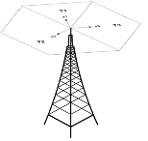
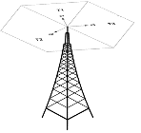





Mobile Telephony Data
Call Detail Records (CDR)
CDR is a data log of recorded Call, SMS and data activities which occur on a mobile operator’s telephony network.
Approximately 1 million customers generating over 1.5 billion records
BS1
BS2
U1
Mobile Operator CDR Collection Server
U2

Slide 5
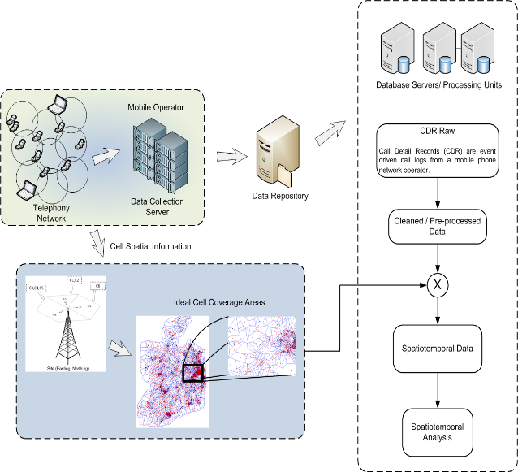
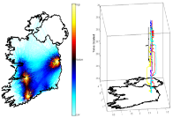
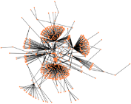
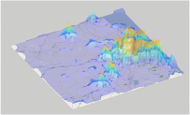
CDR Data Mining
CDR Spatiotemporal Data Types
Trajectory Information
User Social / Cell Network
Cell Activities

Slide 6
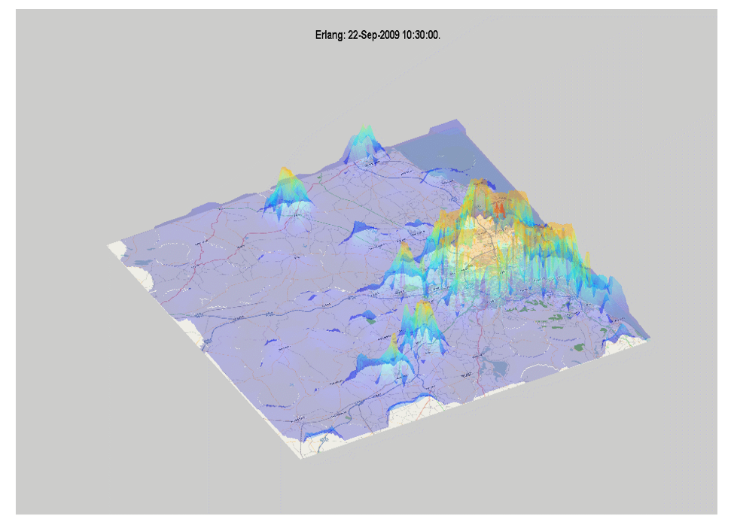

Slide 7
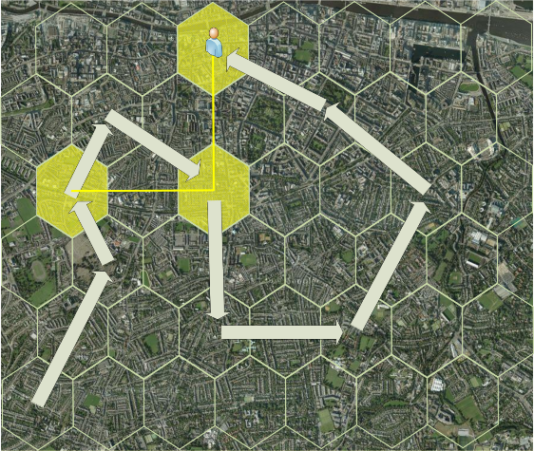
Subscriber Trajectories
Trajectories from CDR only capture cell locations of individuals when they record mobile phone activity

Slide 8
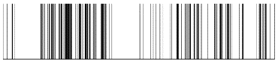
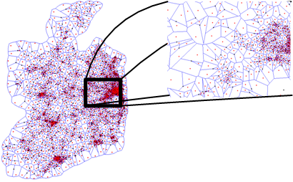
Trajectory Issues
Sampling rate
Spatial Resolution
User activity follow a burst mentality
Location estimates are fixed to cell tower coverage areas
Voronoi cells

Slide 9
Scaling Cells to Regions
Cell Coverage
Spatial Regions of Interest
10721 cells
500 regions

Slide 10
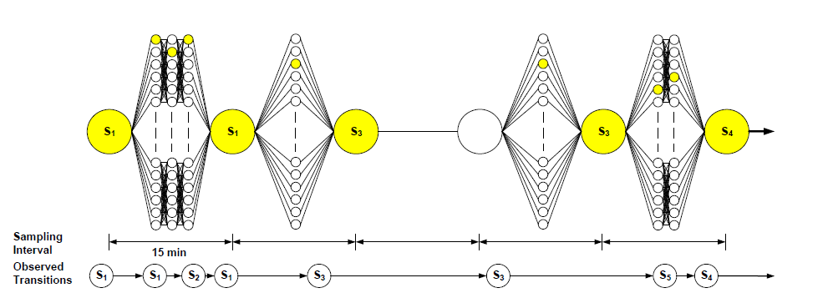
Uniform Sampling
Within each 15-minute temporal window, the estimate of location is based on the last recorded servicing cell tower recorded for that subscriber during that period.
CDR trajectory state sequence sampling of the output sequence S = {S1, S1, S3,
S3, S4}. Smaller yellow circles represent actual regional transitions within a sample period and larger yellow circles represent the observed output transition sequence before resampling.

Slide 11
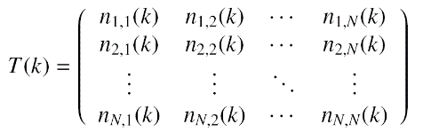
Regional Flows of Subscribers
By observing the flow of people between clustered regions and the geographical areas covered, a proxy for the flow of people between individual population centres can be established. These results can summarised in an aggregated transition matrix T(k),

Slide 12
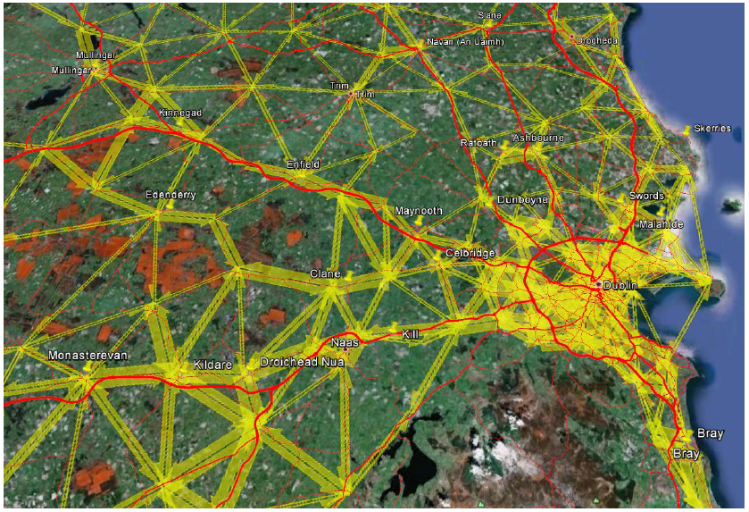
Average Intensity of Subscribers Between Regions

Slide 13
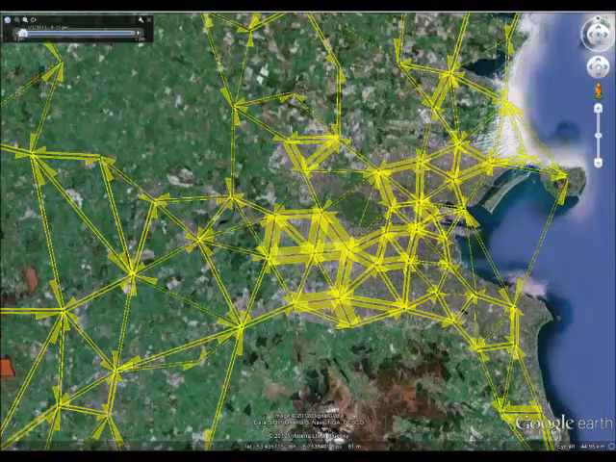
Temporal Flow of Subscribers

Slide 14
Population Estimation
A census is the primary tool used by national governments to gather information on population metrics, which includes among others population count, religious status, material status and household occupancy.
The knowledge obtained dictates future policy on decisions related to the planning of future infrastructure and public services.
While the information gathered is extremely important for the delivery of such services, the cost of carrying out a census is prohibitively expensive. As a result a census may be only carried out every 5-10 years.
Consequently, they provide poor temporal resolution and are incapable of providing information on the current status of a population.
This motivates the requirement for low cost alternatives.

Slide 15
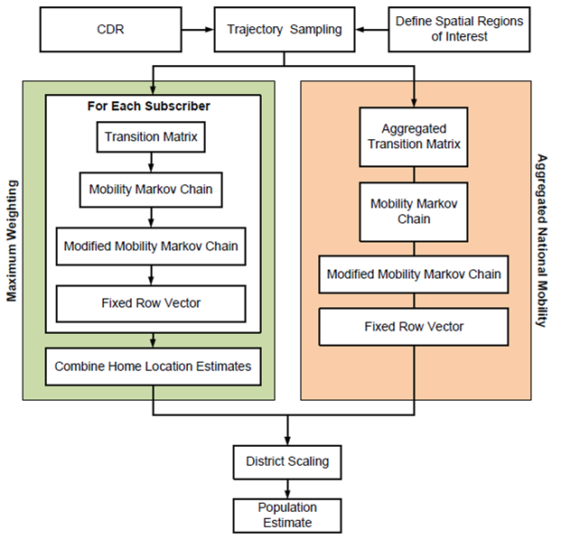

Slide 16
Modelling User Movement
We can model individual user movement with Markov chains.
Homogeneous Markov chains are useful when the state sequence, S(k), k = 0; 1; 2; . . . , is directly observable.
By extracting a subscriber CDR trajectory, it is possible to directly observe an individual subscriber’s cell tower state sequence.
Markov chains may be used to model a mobile subscribers transient movement between the symbolic locations represented by the clustered cell regions.

Slide 17
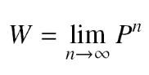
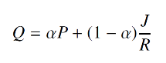
Subscriber Regions of Interest
If a Markov chains is ergodic
where W is a matrix with identical rows w, and all components of w sum to 1.
The fixed row vector, w, of a mobile subscriber’s mobility Markov chain conveys the probability of observing that subscriber at a region in space over a long period of time.
As not all mobility Markov chains are ergodic, introduce a regularisation weight
where Q is a modified Markov chain, R is the number of states, J is a R x R matrix of ones and α balances the learnt mobility patterns summarised by P with the influence of random transition probabilities introduced by the term J/R

Slide 18
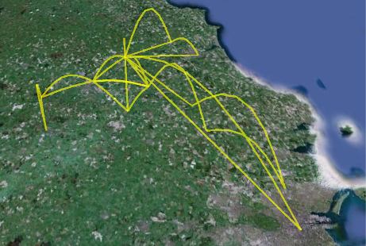
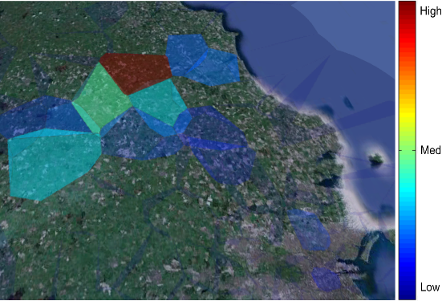
The Q of a randomly select subscriber
Low transition probabilities are not illustrated for visual clarity
The observed regional ranking suggests that the subscriber tends to travel in County Meath, with occasional trips into Dublin City

Slide 19
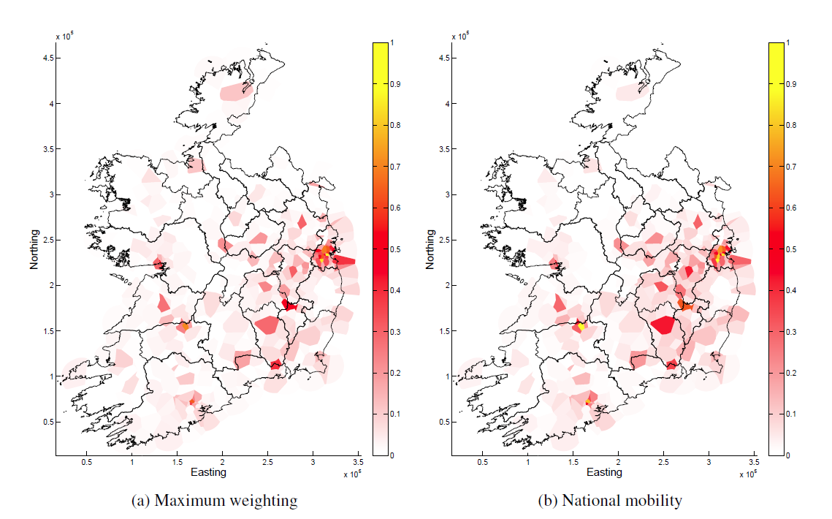
Population Density

Slide 20
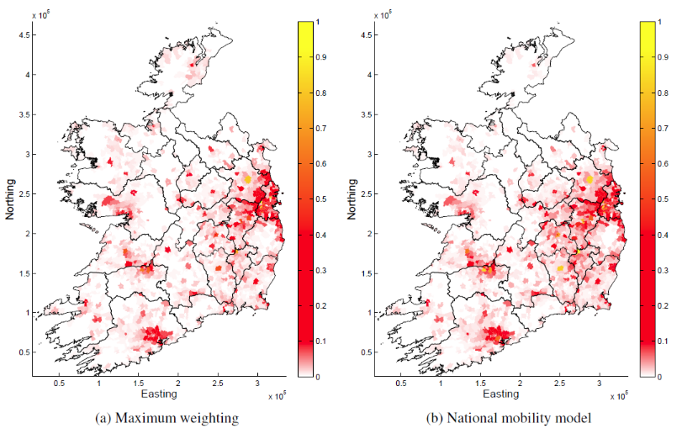
ED Population
Corr – 86.61%
Corr – 84.38%

Slide 21
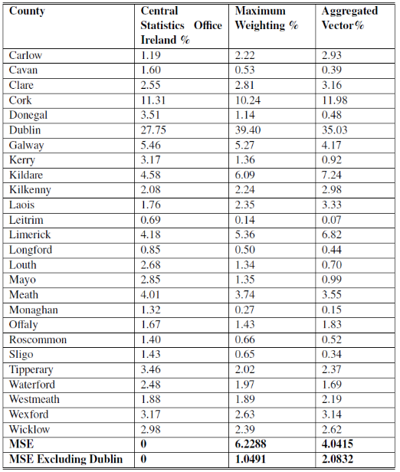
Population Estimation
The correlation between census data and maximum weighting approach is approximately 98.4%.
The correlation between census data and aggregated approach is approximately 97.7%.
However, as performance is restricted by its ability to measure population proportions in different areas, but not the ability to estimate counts, the effectiveness of such techniques for inferring census type data needs further research and is the subject of future work.

Slide 22
Application Areas
Mobile network operators are beginning to see profit margins fall due to
tighter regulation
increasing demand for data services
falling revenues generated from call and SMS traffic
In this context, network operators are increasingly focusing their efforts on
new revenues generation schemes
lower subscriber churn
increasing customer satisfaction rates
However, this shift in focus has unearthed significant gaps in their knowledge of how subscribers use and perceive the mobile services on offer to them.

Slide 23
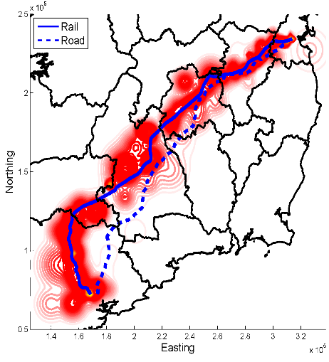
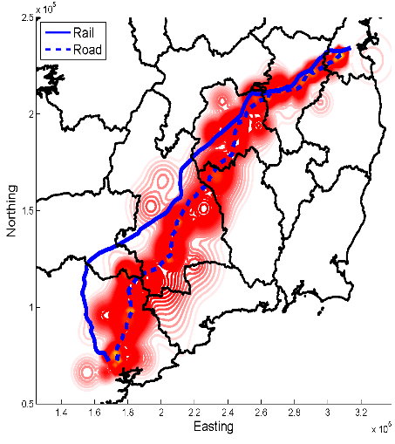
Transportation Planning
Kernel density estimate of journey trajectories identified as travelling along (a) road and (b) rail travel paths.

Slide 24
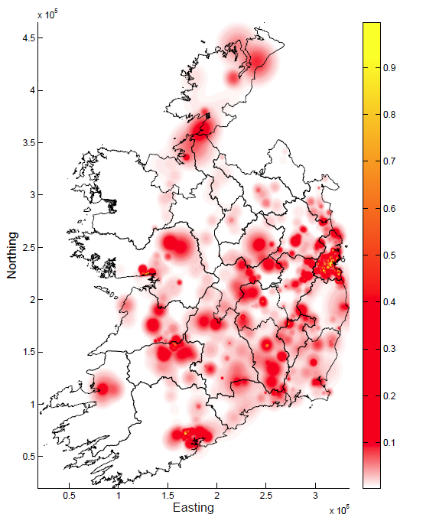
High Mobile Traffic Regions Of Interest
Combine the vector weights of high data usage subscribers
Better understanding of the areas they occupy on a daily basis
Design more efficient networks
Identify coverage black spots
Better data for marketing

Slide 25
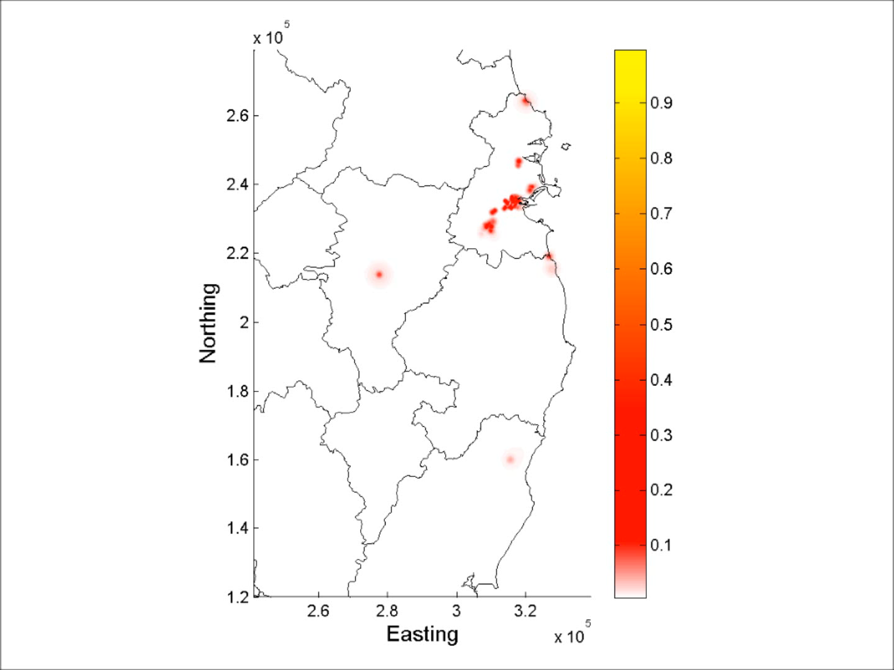
Identify Event Mobility

Slide 26
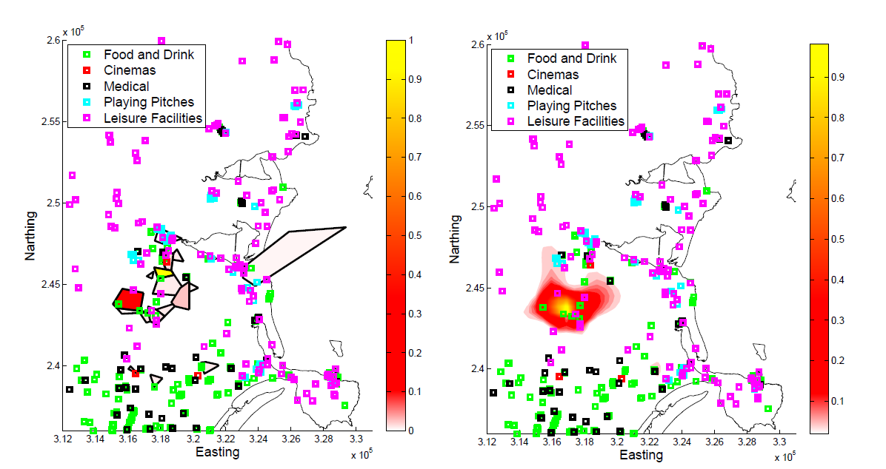
Geographically Weighted Amenities

Slide 27
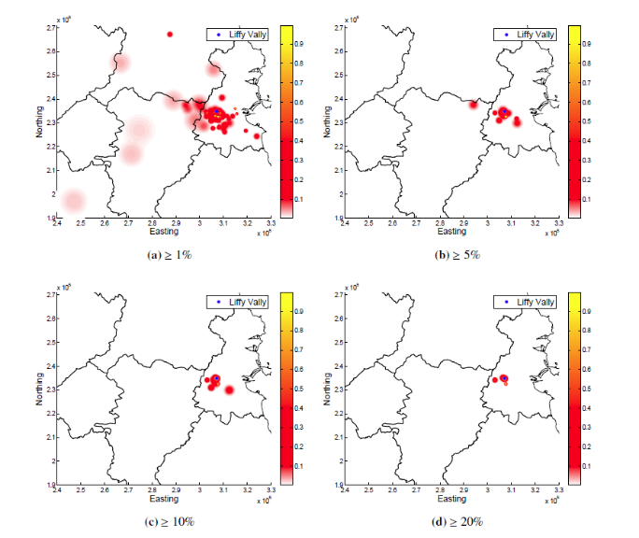
Catchment Area

Slide 28
Acknowledgements
This research was funded by a Strategic Research Cluster grant (07/SRC/I1168) by Science Foundation Ireland under the National Development Plan and by the Irish Research Council under their Embark Initiative in partnership with ESRI Ireland.
I would also like to gratefully acknowledge the support of Meteor for providing the data used in this research, in particular John Bathe and Adrian Whitwham.

Slide 29
Questions?

